Slide 1
Bayesian Learning
Wen-Cheng Lin
Department of Medical Informatics
Tzu Chi University

Slide 2
Basic Formulas for Probabilities
Product Rule: probability P(A∧B) of a conjunction of two events A and B
  P(A∧B) = P(A|B)P(B) = P(B|A)P(A)
Sum Rule: probability of a disjunction of two events A and B
  P(A∨B) = P(A) + P(B) - P(A∧B)
Theorem of total probability: if events A₁,...,A_{n} are mutually exclusive with

Slide 3
Joint Probability Distributions
Joint probability distribution over a set of random variables
  P(X₁, X₂,…X_{n})
All possible joint assignments of values to the variables.

Slide 4
Learning the Joint Distribution
Given a large data set, for each row, calculate the fraction of database entries that satisfy the joint assignment specified for that row.
Problem
  Very large amount of training data may be required
  100 boolean features → 2¹⁰⁰ rows
    For many rows, we may have zero training example.

Slide 5
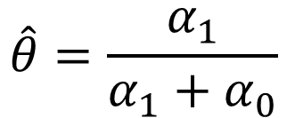
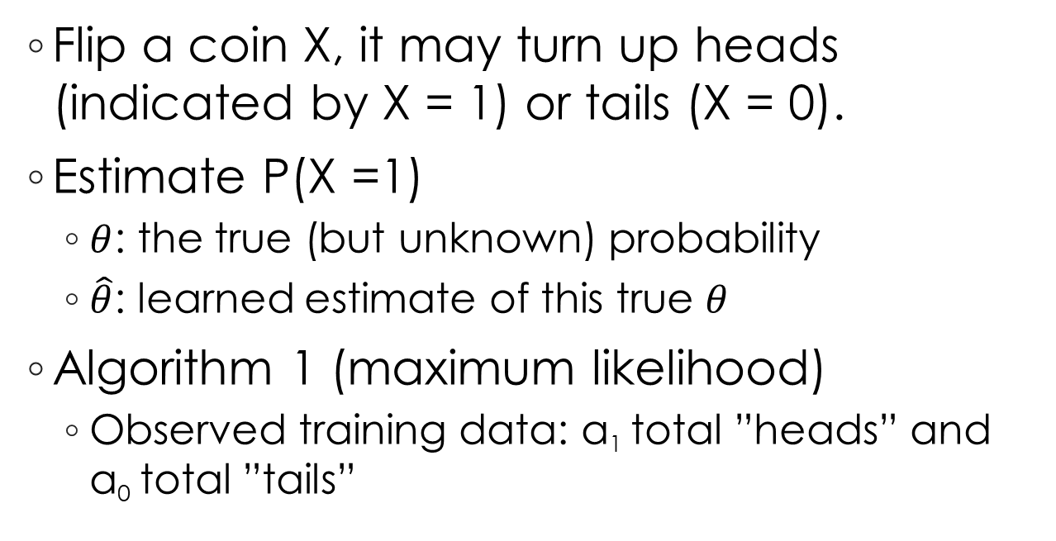
Estimating Probabilities
Flip a coin X, it may turn up heads (indicated by X = 1) or tails (X = 0).
Estimate P(X =1)
  $θ$: the true (but unknown) probability
  $\hat{θ}$: learned estimate of this true $θ$
Algorithm 1 (maximum likelihood)
  Observed training data: α₁ total ”heads” and α₀ total ”tails”
$$\hat{θ}=\frac{α_{1}}{α_{1}+α_{0}}$$
    if the training data is very scarce it can produce unreliable estimates

Slide 6
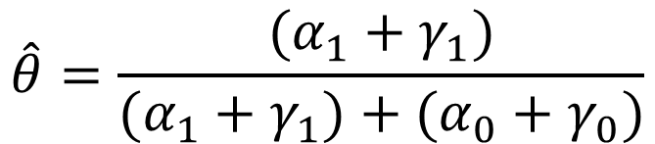
Algorithm 2 (maximum a posteriori probability)
  Incorporate prior assumptions (knowledge) along with observed training data
  Observed training data: α₁ total ”heads” and α₀ total ”tails”
  prior information: γ₁ imaginary ”heads” and γ₀ imaginary ”tails”
$$\hat{θ}=\frac{(α_{1}+γ_{1})}{(α_{1}+γ_{1})+(α_{0}+γ_{0})}$$

Slide 7
Features of Bayesian Learning
Each observed training example can incrementally decrease or increase the estimated probability that a hypothesis is correct
Combine prior knowledge (prior probabilities) with observed data
Accommodate hypotheses that make probabilistic predictions

Slide 8
Features of Bayesian Learning
New instances can be classified by combining the predictions of multiple hypotheses, weighted by their probabilities
Provides gold standard for evaluating other learning algorithms

Slide 9
Practical Difficulty
Requires prior probabilities
  Often estimated based on background knowledge, previously available data
Significant computational cost required to determine the Bayes optimal hypothesis

Slide 10
Bayes Theorem
  where
  P(h) = priori probability of hypothesis h
  P(D) =priori probability of data D
  P(D|h) = probability of D given h
  P(h|D) = probability of h given D (posterior probability)

Slide 11
Choosing Hypotheses
Generally want the most probable hypothesis given the training data
Maximum a posteriori hypothesis h_{MAP}

Slide 12
Choosing Hypotheses
If assume P(h_{i}) = P(h_{j}) then can further simplify and choose the Maximum likelihood (ML) hypothesis
  P(D|h) is often called the likelihood of the data D given h

Slide 13
Bayes Theorem - Example
Does patient have cancer or not
  A patient takes a lab test and the result comes back positive. The test returns a correct positive result in only 98 % of the cases in which the disease is actually present and a correct negative result in only 97% of the cases in which the disease is not present. Furthermore, 0.008 of the entire population have this cancer.

Slide 14
Bayes Theorem - Example
P(cancer) = 0.008 P(¬cancer) = 0.992
P(+|cancer) = 0.98 P(+| ¬cancer)=0.03
P(-|cancer) = 0.02 P(-| ¬cancer)=0.97
h_{MAP}= ¬ cancer
  P(cancer|+)∝P(+|cancer)P(cancer) = 0.98*0.008 = 0.0078
  P(¬ cancer|+) ∝ P(+| ¬ cancer)P(¬ cancer) = 0.03*0.992 = 0.0298

Slide 15
Brute Force MAP Hypothesis Learner
For each hypothesis h in H calculate the posterior probability
Output the hypothesis h_{MAP} with the highest posterior probability

Slide 16
Learning A Real Valued Function
Consider any real valued target function f
Training examples (x_{i}, d_{i}) where d_{i} is noisy training value
  d_{i} = f(x_{i}) + e_{i}
  e_{i} is random variable (noise) drawn independently for each x_{i} according to some Gaussian distribution (Normal distribution) with mean=0
Then the maximum likelihood hypothesis h_{ML} is the one that minimizes the sum of squared errors

Slide 17
Learning A Real Valued Function
Learning a linear function

Slide 18
Learning A Real Valued Function
e_{i} obeys Normal distribution
d_{i} obeys Normal distribution
p(d_{i}|h) obeys Normal distribution
variance σ², mean μ=f(x_{i})
Maximize natural log of this instead

Slide 19
Learning to Predict Probabilities
Consider predicting survival probability from patient data
Training example <x_{i}, d_{i}>, where d_{i}=1 if x_{i} survives, and 0 otherwise
Want to predict the probability that x_{i} survives
h(x_{i}) predicts the probability that d_{i}=1
The negation of the above quantity is sometimes called the cross entropy

Slide 20
Learning to Predict Probabilities
x is independent of h
h(x_{i}) predicts the probability
that x_{i}=1
P(x_{i}) is a constant independent of h

Slide 21
Minimum Description Length Principle
Occam’s razor
  Prefer the shortest hypothesis
MDL
  Prefer the hypothesis h that minimizes
  where L_{C} (x) is the description length of x under encoding C

Slide 22
Minimum Description Length Principle
Fact from information theory:
  The optimal shortest expected coding length code for an event with probability p is -log₂p bits
  -log₂P(h) is the description length of h under optimal encoding
  -log₂P(D|h) is the description length of D given h under optimal encoding

Slide 23
Minimum Description Length Principle
  Let L_{CH}(h) = -log₂P(h), where C_{H} is the optimal code for hypothesis space H
  Let L_{CD|h}(D|h) = -log₂P(D|h), where C_{D|h} is the optimal code for D assuming that both the sender and receiver know the hypothesis h
  If C₁ is C_{H}, C₂ is C_{D|h}, then
  h_{MDL} = h_{MAP}

Slide 24
Minimum Description Length Principle
Example: H=decision trees, D=training data labels
  L_{C1}(h) is # bits to describe tree h
  L_{C2}(D|h) is # bits to describe D given h
    Note L_{C2}(D|h)=0 if examples classified perfectly by h. Need only describe exceptions.
  Prefer the hypothesis that minimizes
  length(h) + length(misclassifications)
  Hence h_{MDL} trades off tree size for training errors

Slide 25
Most Probable Classification of
New Instances
So far we have sought the most probable hypothesis given the data D (i.e. h_{MAP})
Given new instance x, what is its most probable classification?
  h_{MAP}(x) is not the most probable classification!

Slide 26
Most Probable Classification of
New Instances
Consider
  Three possible hypotheses
    P(h₁|D)=0.4, P(h₂|D)=0.3, P(h₃|D) =0.3
  Given new instance x,
    h₁(x) = +, h₂(x) = -, h₃(x) = -,
What’s most probable classification of x?
  h_{MAP} is h₁
  h₁(x) = +
  Is + the most probable classification of x?

Slide 27
Bayes Optimal Classifier
Bayes optimal classification
Example
  P(h₁|D)=0.4, P(-|h₁)=0, P(+|h₁)= 1
  P(h₂|D)=0.3, P(-|h₂)=1, P(+|h₂)= 0
  P(h₃|D)=0.3, P(-|h₃)=1, P(+|h₃)= 0

Slide 28
Bayes Optimal Classifier
Therefore,
and

Slide 29
Bayes Optimal Classifier
Bayes optimal classifier
  Classify new instances according to Bayes optimal classification equation
No other classification method using the same hypothesis space and same prior knowledge can outperform this method on average

Slide 30
Gibbs Classifier
Bayes optimal classifier provides best result but can be expensive if many hypotheses
Gibbs algorithm
  Choose one hypothesis at random according to P(h|D)
  Use this hypothesis to classify new instance

Slide 31
Gibbs Classifier
Surprising fact
  Assume target concepts are drawn at random from H according to priors on H. Then
  E[error_{Gibbs}] ≤ 2E[error_{BayesOptimal}]
Suppose correct, uniform prior distribution over H, then
  Pick any hypothesis from VS, with uniform probability
  Its expected error no worse than twice Bayes optimal

Slide 32
Naive Bayes Classifier
Along with decision trees, neural networks, nearest nbr, one of the most practical learning methods
When to use
  Moderate or large training set available
  Attributes that describe instances are conditionally independent given classification
Successful applications
  Diagnosis
  Classifying text documents

Slide 33
Naive Bayes Classifier
Assume target function f:X→V, where each instance x described by attributes (a₁, ..., a_{n})
Most probable value of f(x) is:

Slide 34
Naive Bayes Classifier
Naive Bayes assumption
Which gives
Naive Bayes classifier
  v_{NB} denotes the target value output by the naive Bayes classifier

Slide 35
Naive Bayes Algorithm
Naive_Bayes_Learn(examples)
  For each target value v_{j}
  For each attribute value a_{i} of each attribute a
Classify_New_Instance(x)

Slide 36
Naive Bayes: Example
Consider PlayTennis again and new instance
  (Outlook=sunny, Temperature=cool, Humidity=high, Wind= strong)
Want to compute

Slide 37
Naive Bayes: Example
Training examples

Slide 38
Naive Bayes: Example
  P(PlayTennis=yes)=9/14=0.64
  P(PlayTennis=no)=5/14=0.36
  P(Wind=strong|PlayTennis=yes)=3/9=0.33
  P(Wind=strong|PlayTennis=no)=3/5=0.60
  …
  P(yes)P(sunny|yes)P(cool|yes)P(high|yes)
  P(strong|yes)=0.0053
  P(no)P(sunny|no)P(cool|no)P(high|no)
  P(strong|no)=0.0206
v_{NB} = no

Slide 39
Naive Bayes: Subtleties
Conditional independence assumption is often violated
  But it works surprisingly well anyway. Note don’t need estimated posteriors to be correct; need only that
  Naive Bayes posteriors often unrealistically close to 0 or 1

Slide 40
Naive Bayes: Subtleties
What if none of the training instances with target value v_{j} have attribute value a_{i}? Then
Typical solution is Bayesian estimate for
  m-estimate of probability

Slide 41
Naive Bayes: Subtleties
  where
  n is the number of training examples for which v = v_{j}
  n_{c} is the number of examples for which v = v_{j} and a = a_{i}
  p is prior estimate for (usually assume uniform priors)
  m is weight given to prior (i.e. number of “virtual” examples)

Slide 42
Learning to Classify Text
Why
  Learn which news articles are of interest
  Learn to classify web pages by topic
Naive Bayes is among most effective algorithms
What attributes shall we use to represent text documents?

Slide 43
Learning to Classify Text
Target concept
  Interesting: Document→{+,-}
Represent each document by vector of words
  one attribute per word position in document
    Example: Last paragraph, page 180
    Our approach to representing ……any trouble.
    111 words
    <our, approach, to, ……, any, trouble>

Slide 44
Learning to Classify Text
Learning Use training examples to estimate
  P(+), P(-), P(doc|+), P(doc|-)
Naive Bayes conditional independence assumption
  where P(a_{i}=w_{k}|v_{j}) is probability that word in position i is w_{k}, given v_{j}

Slide 45
Learning to Classify Text
The independence assumption of words in different positions are incorrect. However, without this assumption, the number of probability terms that must be computed is prohibitive

Slide 46
Learning to Classify Text
Estimate probability
  P(v_{j}): fraction of each class in the training data
  P(a_{i}=w_{k}|v_{j})
    One probability for each combination of text position, English word, and target value
    111 positions, 50000 distinct words, 2 target value
      111*50000*2 ≈ 10 million
    Additional assumption
      P(a_{i}=w_{k}|v_{j})=P(a_{m}=w_{k}|v_{j}), ∀i,m
    Estimate P(w_{k}|v_{j})
      50000*2

Slide 47
Learning to Classify Text
Estimate P(w_{k}|v_{j})
  where
  n is the total number of word positions in all training examples whose target value is v_{j}
  n_{k} is the number of times word w_{k} is found among these n word positions
  |Vocabulary| is the total number of distinct words found within the training data

Slide 48
Learning to Classify Text
Learn_Naive_Bayes_Text(Examples, V)
Collect all words and other tokens that occur in Examples
  Vocabulary← all distinct words and other tokens in Examples
Calculate the required P(v_{j}) and P(w_{k}|v_{j}) probability terms
  For each target value v_{j} in V do
    docs_{j} ← subset of Examples for which the target value is v_{j}
    P(v_{j}) ← |docs_{j}| / |Examples|
    Text_{j} ← a single document created by concatenating all members of docs_{j}
    n ← total number of words in Text_{j} (counting duplicate words multiple times)
    for each word w_{k} in Vocabulary
      n_{k} ← number of times word w_{k} occurs in Text_{j}
      P(w_{k}|v_{j}) ← (n_{k}+1) / (n+|Vocabulary|)

Slide 49
Learning to Classify Text
Classify_Naive_Bayes_Text(Doc)
positions ← all word positions in Doc that contain tokens found in Vocabulary
Return v_{NB} where
  Any words appearing in the new document that were not observed in the training set are simply ignored

Slide 50
Experiment
Twenty NewsGroups
  Given training documents from each group. Learn to classify new documents according to which newsgroup it came from
  comp.graphics misc.forsale
  comp.os.ms-windows.misc rec.autos
  comp.sys.ibm.pc.hardware rec.motorcycles
  comp.sys.mac.hardware rec.sport.baseball
  comp.windows.x rec.sport.hockey
  sci.space sci.crypt sci.med sci.electronics
  soc.religion.christian talk.religion.misc
  talk.politics.mideast talk.politics.misc
  talk.politics.guns alt.atheism
  Naive Bayes: 89% classification accuracy

Slide 51
Experiment
Only a subset of the words occurring in the documents were included in Vocabulary
  Remove top 100 most frequent words
    Stopword: the, of, in, …
  Remove the words occurring fewer than 3 times
  |Vocabulary| ≈ 38,500

Slide 52
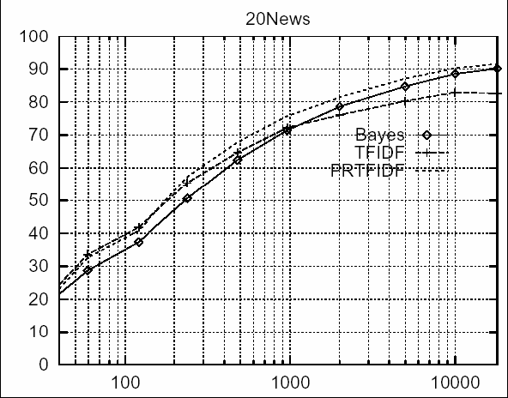
Learning Curve for 20 Newsgroups
Accuracy vs. Training set size (1/3 withheld for test)

Slide 53
Bayesian Belief Networks
Interesting because
  Naive Bayes assumption of conditional independence too restrictive
  But it’s intractable without some such assumptions...
  Bayesian belief networks describe conditional independence among subsets of variables
Allows combining prior knowledge about (in)dependencies among variable with observed training data
also called Bayes Nets

Slide 54
Conditional Independence
Definition: X is conditionally independent of Y given Z if the probability distribution governing X is independent of the value of Y given the value of Z; that is, if
more compactly, we write
P(X|Y,Z)=P(X|Z)

Slide 55
Conditional Independence
Example: Thunder is conditionally independent of Rain, given Lightning
P(Thunder|Rain,Lightning) = P(Thunder|Lightning)
Naive Bayes uses conditional independence to justify
P(X,Y|Z) = P(X|Y,Z)P(Y|Z) = P(X|Z)P(Y|Z)

Slide 56
Bayesian Belief Network
Network represents a set of conditional independence assertions
  Each node is asserted to be conditionally independent of its nondescendants given its immediate predecessors
  Directed acyclic graph

Slide 57
Bayesian Belief Network
Represents joint probability distribution over all variables
  e.g. P(Storm,BusTourGroup,…,ForestFire)
  in general
    where Parents(Y_{i}) denotes immediate predecessors of Y_{i} in graph
  So joint distribution is fully defined by graph plus the P(y_{i}|Parents(Y_{i}))

Slide 58
Bayesian Belief Network
Let A(X) be any set of nodes in the graph that are not descendants of X, and let Parents(X) be the immediate parents of X in the graph. The graph is simply a way of stating that for all X in the graph, P(X|A(X),Parents(X))=P(X|Parents(X))

Slide 59
Inference in Bayesian Networks
How can one infer the (probabilities of) values of one or more network variables, given observed values of others?
  Bayes net contains all information needed for this inference
  If only one variable with unknown value, easy to infer it
  In general case, problem is NP hard (Cooper 1990)

Slide 60
Inference in Bayesian Networks
In practice, can succeed in many cases
  Exact inference methods work well for some network structures
  Monte Carlo methods “simulate” the network randomly to calculate approximate solutions (still NP-hard, Dagum and Luby 1993)

Slide 61
Inference in Bayesian Networks
內容摘自 海洋大學資訊工程學系 張欽圳 教授 機器學習課程講義

Slide 62
Patterns of Inference in
Bayesian Networks
Causal or Top-down inference Compute P(M|L).
  P(M|L)=P(M,B|L)+P(M,¬B|L)
  =P(M|B,L)P(B|L)+P(M|¬B,L)P(¬B|L)
  =P(M|B,L)P(B)+P(M|¬B,L)P(¬B)
  =0.855
Steps
  Rewrite the desired conditional probability of the query node V, given the evidence, in terms of the joint probability of V and all of its parents, given the evidence.
  Reexpress this joint probability back to the probability of V conditioned on all of the parents.
內容摘自 海洋大學資訊工程學系 張欽圳 教授 機器學習課程講義

Slide 63
Patterns of Inference in
Bayesian Networks
Bottom-up inference, Compute P(¬L|¬M).
  P(¬L|¬M)=P(¬M|¬L)P(¬L) /P(¬M)
  =0.9525*0.3/P(¬M)
  P(L|¬M)=P(¬M|L)P(L) /P(¬M)
  =0.03665/P(¬M)
  Since P(¬L|¬M)+P(L|¬M)=1, we have P(¬L|¬M)=0.88632.
The main step is to use Bayes’ rule to convert the problem into one of causal reasoning.
內容摘自 海洋大學資訊工程學系 張欽圳 教授 機器學習課程講義

Slide 64
Patterns of Inference in
Bayesian Networks
Explain away, Compute P(¬L| ¬B,¬M).
  P(¬L|¬B,¬M)=P(¬B,¬M|¬L)P(¬L)/P(¬B,¬M) (Bayes’ rule)
  =P(¬M|¬B, ¬L)P(¬B| ¬L)P(¬L)/P(¬B,¬M)
  =P(¬M|¬B, ¬L)P(¬B)P(¬L)/P(¬B,¬M)
內容摘自 海洋大學資訊工程學系 張欽圳 教授 機器學習課程講義

Slide 65
Learning of Bayesian Networks
Several variants of this learning task
  Network structure might be known or unknown
  Training examples might provide values of all network variables, or just some
If structure known and observe all variables
  Then it’s easy as training a Naive Bayes classier

Slide 66
Learning of Bayesian Networks
Suppose structure known, variables partially observable
  e.g. observe ForestFire, Storm, BusTourGroup, Thunder, but not Lighting and Campfire
  Similar to training neural network with hidden units
  In fact, can learn network conditional probability tables using gradient ascent
  Converge to network h that (locally) maximizes P(D|h)

Slide 67
Gradient Ascent for Bayes Nets
Let w_{ijk} denote one entry in the conditional probability table for variable Y_{i} in the network
w_{ijk} = P(Y_{i} = y_{ij}|Parents(Y_{i}) = the list u_{ik} of values)
  e.g. if Y_{i} =Campfire, then u_{ik} might be (Storm=T,BusTourGroup=F)

Slide 68
Gradient Ascent for Bayes Nets
Perform gradient ascent by repeatedly
  Update all w_{ijk} using training data D
  then, renormalize the w_{ijk} to assure

Slide 69
More on learning Bayes Nets
EM algorithm can also be used. Repeatedly:
  1. Calculate probabilities of unobserved variables, assuming h
  2. Calculate new w_{ijk} to maximize E[ln P(D|h)] where D now includes both observed and (calculated probabilities of) unobserved variables

Slide 70
More on learning Bayes Nets
When structure unknown
  Algorithms use greedy search to add/subtract edges and nodes
  Active research topic

Slide 71
Summary: Bayesian Belief Networks
Combine prior knowledge with observed data
  Impact of prior knowledge (when correct!) is to lower the sample complexity
Active research area
  Extend from boolean to real-valued variables
  Parameterized distributions instead of tables
  Extend to first-order instead of propositional systems
  More effective inference methods

Slide 72
Expectation Maximization (EM)
When to use
  Data is only partially observable
  Unsupervised clustering (target value unobservable)
  Supervised learning (some instance attributes unobservable)
Some uses
  Train Bayesian Belief Networks
  Unsupervised clustering (AUTOCLASS)
  Learning Hidden Markov Models

Slide 73
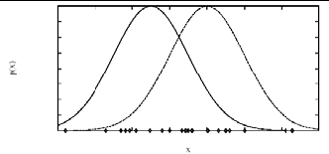
Generating Data from Mixture of k Gaussians
Each instance x generated by
  1. Choosing one of the k Gaussians with uniform probability
  2. Generating an instance at random according to that Gaussian

Slide 74
EM for Estimating k Means
Given
  Instances from X generated by mixture of k Gaussian distributions
  Unknown means (μ₁, ..., μ_{k}) of the k Gaussians
  Don’t know which instance x_{i} was generated by which Gaussian
Determine
  Maximum likelihood estimates of (μ₁, ..., μ_{k})

Slide 75
EM for Estimating k Means
Think of full description of each instance as y_{i} =(x_{i}, z_{i1}, z_{i2})
  where
  z_{ij} is 1 if x_{i} generated by jth Gaussian
  x_{i} observable
  z_{ij} unobservable

Slide 76
EM for Estimating k Means
EM Algorithm:
Pick random initial h= (μ₁, μ₂), then iterate
  E step: Calculate the expected value E[z_{ij}] of each hidden variable z_{ij} assuming the current hypothesis h= (μ₁, μ₂) holds

Slide 77
EM for Estimating k Means
  M step: Calculate a new maximum likelihood hypothesis h’= (μ’₁, μ’₂), assuming the value taken on by each hidden variable z_{ij} is its expected value E[z_{ij}] calculated above. Replace h= (μ₁, μ₂) by h’= (μ’₁, μ’₂).

Slide 78
EM Algorithm
Converges to local maximum likelihood h and provides estimates of hidden variables z_{ij}
In fact, local maximum in E[ln P(Y |h)]
  Y is complete (observable plus unobservable variables) data
  Expected value is taken over possible values of unobserved variables in Y

Slide 79
General EM Problem
Given
  Observed data X = {x₁, ..., x_{m}}
  Unobserved data Z = {z₁, ..., z_{m}}
  Parameterized probability distribution P(Y|h) where
    Y={y₁,...,y_{m}} is the full data y_{i}=x_{i}∪z_{i}
    h are the parameters
Determine
  h that (locally) maximizes E[ln P(Y |h)]

Slide 80
General EM Method
Define likelihood function Q(h’|h) which calculates Y=X∪Z using observed X and current parameters h to estimate Z Q(h’|h)← E[ln P(Y |h’)|h,X]

Slide 81
General EM Method
EM Algorithm:
  Estimation (E) step: Calculate Q(h’|h) using the current hypothesis h and the observed data X to estimate the probability distribution over Y
  Q(h’|h)← E[ln P(Y |h’)|h,X]
  Maximization (M) step: Replace hypothesis h by the hypothesis h’ that maximizes this Q function

